Slide 1
Cell Observation
WBS, RBC & Platelets

Slide 2
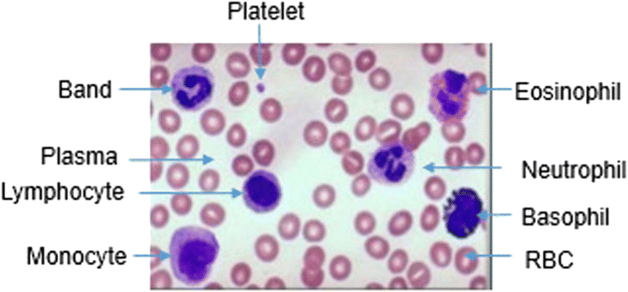

Slide 3
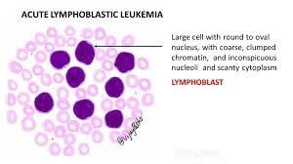

Slide 4
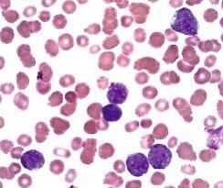

Slide 5
